Slide 1
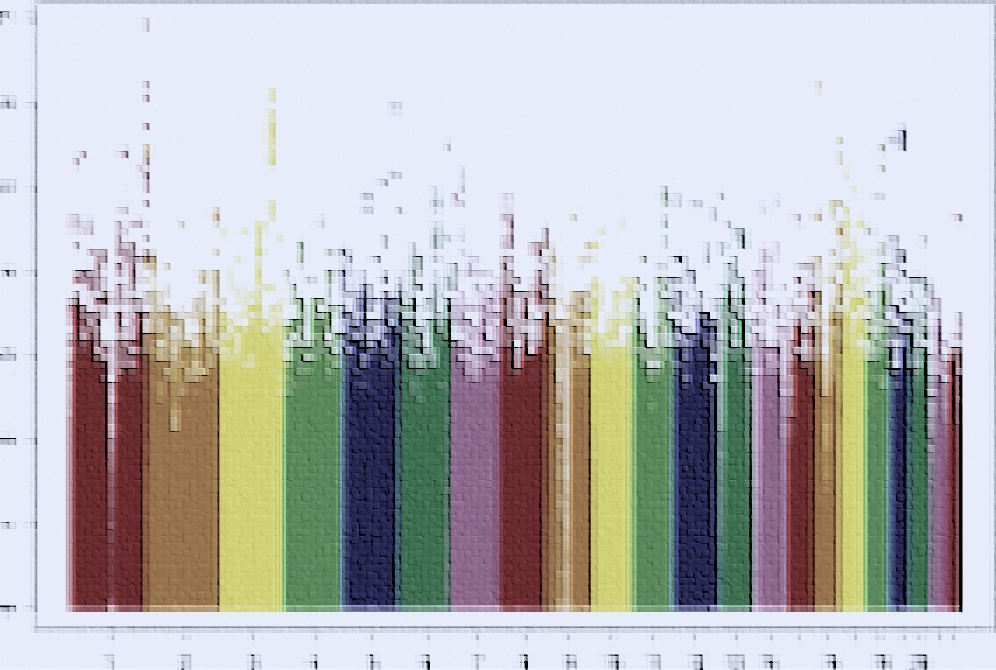

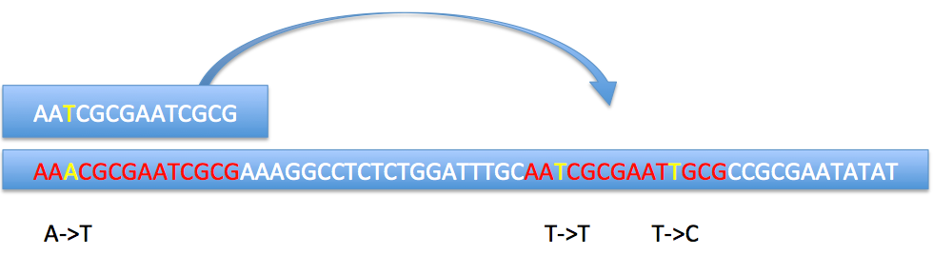
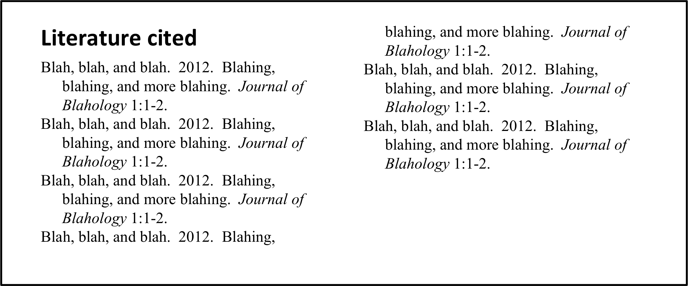

Steven Flygare, Brett Kennedy, Lynn Jorde, Martin Reese, Mark Yandell
Address(es)
Introduction
Genome wide searches for disease causing variants are complicated by false positives arising from many different sources. Incorporating genomic information that is location specific can result in a dramatic increase in power in genome-wide variant searches. We show that the power of VAAST to find disease causing variants is greatly increased by including information specific to a variant location. Genome-wide searches using VAAST were performed on the combined exome sequence data for three unrelated individuals with known disease causing variants from HGMD spiked into this dataset. By using the VQSR procedure and filtering the variants based on tranche values, > 30% increase in power was observed in VAAST’s ability to correctly identify the spiked variants. We also introduce the concept of what we term an ‘adjacency’ value, which is a measure of genome complexity. It is computed by allowing reads to align up to 10 valid, distinct genomic locations and then counting the number of times a base pair location in the genome is represented by reads that map to multiple locations. By using these adjacency values to inform VAAST, a power increase > 40% was observed in the VAAST searches. Both adjacency values and VQSLOD scores produced by the VQSR procedure are position specific weights that can be used in genome wide searches to dramatically increase power.
Results
Blah, blah, blah
Conclusions
Blah, blah, blah
© File copyright Colin Purrington. You may use for making your poster, of course, but please do not plagiarize, adapt, or put on your own site. Also, do not upload this file, even if modified, to third-party file-sharing sites such as doctoc.com. If you have insatiable need to post a template onto your own site, search the internet for a different template to steal. File downloaded from http://colinpurrington.com/tips/academic/posterdesign.
Materials and methods
All benchmarks were done on the combined exome data of 3 healthy, unrelated individuals. We spiked known disease causing variants from the HGMD database into the combined exome data and then used VAAST to search for the spiked variants. We spiked variants into 100 genes and then recorded their ranks as judged by VAAST. The VQSR procedure in the GATK pipeline was used to compute VQSLOD scores, which were multiplied with the VAAST likelihood to weight the variant site. Adjacency values were computed by using Bowtie2 to align each read from the exome sequence data up to 10 distinct times. The following simple figure shows how adjacency values are calculated:
In this simple case each base pair under the read would have an adjacency value of two. The VAAST likelihood was multiplied by the percentile rank of the adjacency value to weight the variant site.
Further information
© File copyright Colin Purrington. You may use for making your poster, of course, but please do not plagiarize, adapt, or put on your own site. Also, do not upload this file, even if modified, to third-party file-sharing sites such as doctoc.com. If you have insatiable need to post a template onto your own site, search the internet for a different template to steal. (Replace this text with your own.)
Acknowledgments
Blah, blah, blah.
Notes:
Copyright Colin Purrington (http://colinpurrington.com/tips/academic/posterdesign).

